Slide 1
Gaian Asset Training Day
Distributed processing techniques.
Patrick Dantressangle
David Vyvyan, Paul Stone
IBM Confidential

Slide 2
How to Simulate a MAP-Reduce processing with GaianDB.
2 data distribution scenarios:
  The data is already naturally partitioned for the processing required ( not MAP required then )
  The data is not partitioned for the processing and therefore need distribution of data to the GDBs involved for processing collocation.
Overall high level process
  Create a distribution map ( i.e. a logical table with keys and ranges, or this can be inlined within the MAP queries itself)
  Execute the MAP stage by executing it using a GaianQuery() so it will distribute the data across the GDB nodes.
  Execute the distributed processing ( i.e. Another GaianQuery() using _0 for the Logical tables to ensure local processing)
  Execute more distributed processing if required….eventually reducing intermediate data into distributed local temp tables
  Finally Reduce by Selecting from the distributed data on the master node, adding extra final processing for final aggregation.
Things to take care of.
  Understand if moving the data is better of not. Shuffling too much data around may not be beneficial ( do some stats)
  Minimize the number of SQL queries as this will make things more efficient.
  Don’t hesitate to create JAVA UDFs to allow more complex processing at every node and deploy them in all Gaian. (see Derby JAVA UDF creation here https://db.apache.org/derby/docs/10.2/ref/rrefcreatefunctionstatement.html)
One can write a JAVA procedure for dealing with this pattern automatically.

Slide 3
Scenario
Use the London BIKEs data to calculate in a distributed manner
  Distribute the data from all locations into 3 GaianDB roughly evenly so we can use 3 nodes to do the calculations
  Calculate the Number of bikes per areaname (aggregate multiple locations per area)
  Flag True if the whole areaname is full. (current number of bikes = maximum)
  Keep of clean intermediate tables for reuse.

Slide 4
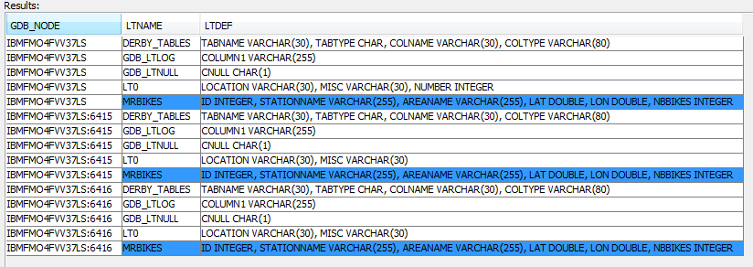
Prepare the data for the scenario – Step 0 (copy statements from notes instead of slides)
Make sure all configx.properties have the following flag set to true: (so we can update things remotely)
  ALLOW_PROPAGATED_WRITES=TRUE
  ALLOW_SQL_API_CONFIGURATION=TRUE
Launch multiple nodes.(run launchMultipleNodes.bat )
Create the logical table definition on all nodes as a distributed sub-query:
  SELECT * FROM NEW com.ibm.db2j.GaianQuery(‘
  call setlt(''MRBIKES'',''id INTEGER, stationName VARCHAR(255), areaName VARCHAR(255),
  lat DOUBLE,lon DOUBLE, nbBikes INTEGER,nbEmptyDocks INTEGER, installed BOOLEAN,
  locked BOOLEAN, temp BOOLEAN'','''')
  ', 'with_provenance') GQ
Verify that all LT are created on all nodes.
  call listlts()
Notes:
SELECT * FROM NEW com.ibm.db2j.GaianQuery('DROP TABLE Q1_parts','with_provenance') Q_drop
SELECT * FROM NEW com.ibm.db2j.GaianQuery('DROP TABLE T1_PART','with_provenance') Q_drop
SELECT * FROM NEW com.ibm.db2j.GaianQuery('DROP TABLE T1_out','with_provenance') Q_drop
----------- Set LT MRBIKES....
SELECT * FROM NEW com.ibm.db2j.GaianQuery('call setlt(''MRBIKES'',''id INTEGER, stationName VARCHAR(40), areaName VARCHAR(30), lat DOUBLE,lon DOUBLE, nbBikes INTEGER,nbEmptyDocks INTEGER, installed BOOLEAN,locked BOOLEAN, temp BOOLEAN''
,'''')', 'with_provenance') GQ
call listlts()

Slide 5
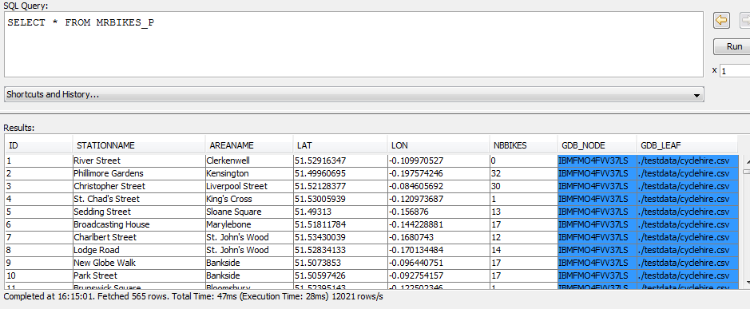

Prepare the data for the scenario – Step 0 (copy statements from notes instead of slides)
Copy the cyclehire.csv into %GaianHOME%/testdata directory
From dashboard, only Federate the csv file directly in main gaian ( port 6414)
(should be in gaiandb_config.properties)
  call setdsfile('MRBIKES','DS0','./testdata/cyclehire.csv', 'MAP_COLUMNS_BY_POSITION' ,'')
  SELECT * FROM MRBIKES_P
  data should all coming from a single node
  Verify that only one nodes retrieves data (distributed subquery to count every node’s data)
  SELECT * FROM NEW com.ibm.db2j.GaianQuery(‘SELECT count(*) FROM MRBIKES_0',
  'with_provenance') GQ
Notes:
-----------------SET local GAIAN 6414 to federate the whole file. and verify ...
call setdsfile('MRBIKES','DS0','./testdata/cyclehire.csv', 'MAP_COLUMNS_BY_POSITION' ,'')
--ID,SUBSTR(STATIONNAME,1,50) STATIONNAME, SUBSTR(AREANAME,1,50) AREANAME,lat ,lon , nbBikes ,nbEmptyDocks , installed ,locked , temp
SELECT * FROM MRBIKES_P
SELECT * FROM NEW com.ibm.db2j.GaianQuery('SELECT count(*) FROM MRBIKES_0','with_provenance') GQ

Slide 6
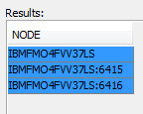

MAP-REDUCE WORKFLOW Step 1 non partitioned
(if naturally partitioned, nothing to do here)
MRBIKES
Create the partitions to be used for distributed processing into a local table in the requester node (6414) if the data is not already partitioned naturally. In our case, partition by text key arbitrarily as the data is on one node only/
Insert the data in that table in all nodes.
NOTE: you could also only use one LT available to every node, but here wanted to show you how to distribute values to all nodes
-----Get the list of nodes in your gaianNetwork:
call listnodes()
SELECT * FROM NEW com.ibm.db2j.GaianQuery('
CREATE TABLE Q1_parts(gdbnode varchar(50),
lowkey varchar(10),
highkeyvarchar(10))
', 'with_provenance') GQ
SELECT * FROM NEW com.ibm.db2j.GaianQuery('INSERT INTO Q1_parts
VALUES(''IBMFMO4FVV37LS'', ''A'','‘F''),
(''IBMFMO4FVV37LS:6415'','‘G'','‘L''),
(''IBMFMO4FVV37LS:6416'',''M'',''Z'')
','') Q_insert_part_info
MRBIKES
GDB 6414
Q1 Parts
GDB1 A H
GDB2 H L
GDB3 L ZZ
GDB
6415
GDB
6416
Q1 Parts
GDB1 A H
GDB2 H L
GDB3 L ZZ
Q1 Parts
GDB1 A H
GDB2 H L
GDB3 L ZZ
MRBIKES
MRBIKES
Note: One can ignore these 2 SQL queries without the need to create the Q1_Parts as he Values statements can be combined with the next SQL queries.
Notes:
------------------ Set the tables for distributing the data....
SELECT * FROM NEW com.ibm.db2j.GaianQuery('
CREATE TABLE Q1_parts(gdbnode varchar(50), lowkey varchar(10), highkey varchar(10))
', 'with_provenance') GQ
------verify that all tables were created on all nodes.
SELECT * FROM NEW com.ibm.db2j.GaianQuery('select count(*) from Q1_parts', 'with_provenance') GQ
call listlts()
call listnodes()
SELECT * FROM NEW com.ibm.db2j.GaianQuery('INSERT INTO Q1_parts
VALUES( ''IBMFMO4FVV37LS'', ''A'',''F''),
(''IBMFMO4FVV37LS:6415'',''F'',''N''),
(''IBMFMO4FVV37LS:6416'',''N'',''Z'')
','') Q_insert_part_info
SELECT * FROM NEW com.ibm.db2j.GaianQuery('select count(*) from Q1_parts', 'with_provenance') GQ

Slide 7

MAP-REDUCE WORKFLOW Step 2 – Shuffle/Distribute
Distribute the T1 data into a new T1_part table on every node according to the partition table.
SELECT * FROM NEW com.ibm.db2j.GaianQuery(
'CREATE TABLE T1_PART(id INTEGER,stationName VARCHAR(255),
areaName VARCHAR(255),lat DOUBLE,lon DOUBLE,
nbBikes INTEGER,nbEmptyDocks INTEGER,
installed BOOLEAN,locked BOOLEAN,temp BOOLEAN
','with_provenance') Q_create
SELECT * FROM NEW com.ibm.db2j.GaianQuery('select count(*) from T1_part', 'with_provenance') GQ
Should respond with 0 in all nodes…
SELECT * FROM NEW com.ibm.db2j.GaianQuery(
'INSERT INTO T1_PART
SELECT *
FROM MRBIKES T1,Q1_parts Q1
WHERE gdb_node()=Q1.gdbnode
AND T1.areaName between lowkey AND highkey
','with_provenance') Q_distribute
Verify the distribution in all T1_Part:
SELECT *
FROM NEW com.ibm.db2j.GaianQuery(‘SELECT count(*) cl, Min(areaname) mn,
max(areaname) mx
FROM T1_part‘
, 'with_provenance') GQ
MRBIKES
GDB 6414
Q1 Parts
GDB1 A H
GDB2 H L
GDB3 L ZZ
MRBIKES
T1_Part
GDB
6415
GDB
6416
MRBIKES
T1_Part
MRBIKES
T1_Part
Q1 Parts
GDB1 A H
GDB2 H L
GDB3 L ZZ
Q1 Parts
GDB1 A H
GDB2 H L
GDB3 L ZZ
Notes:
-----------------distribute the data to every nodes relevant to map/reduce
SELECT * FROM NEW com.ibm.db2j.GaianQuery('drop table T1_PART','with_provenance') Q_1
SELECT * FROM NEW com.ibm.db2j.GaianQuery('CREATE TABLE T1_PART(id INTEGER,stationName VARCHAR(255), areaName VARCHAR(255), lat DOUBLE,lon DOUBLE, nbBikes INTEGER,nbEmptyDocks INTEGER, installed BOOLEAN,locked BOOLEAN, temp BOOLEAN)
','with_provenance') Q_create
-------verify that they are all created.
call listderbytables()
--make sure all are empty ....
SELECT * FROM NEW com.ibm.db2j.GaianQuery('select count(*) from T1_part', 'with_provenance') GQ
SELECT * FROM NEW com.ibm.db2j.GaianQuery('INSERT INTO T1_PART
SELECT id,stationName,areaName,lat,lon,nbBikes,nbEmptyDocks,installed,locked,T1.temp
FROM MRBIKES T1,Q1_parts Q1
WHERE gdb_node()=Q1.gdbnode
AND T1.areaName between lowkey AND highkey
','with_provenance') Q_distribute
SELECT * FROM NEW com.ibm.db2j.GaianQuery('select count(*) cl,Min(areaname) mn,max(areaname) mx from T1_part', 'with_provenance') GQ
---results
---159 IBMFMO4FVV37LS jdbc:derby:gaiandb;create=true
---181 IBMFMO4FVV37LS:6415 jdbc:derby:gaiandb6415;create=true
---225 IBMFMO4FVV37LS:6416 jdbc:derby:gaiandb6416;create=true
--count that all data has been distributeed to all nodes...
SELECT sum(c) FROM NEW com.ibm.db2j.GaianQuery('
SELECT count(*) c
FROM T1_PART
','with_provenance') Q_distribute

Slide 8

MAP-REDUCE WORKFLOW Step 3 Reduce-process
MRBIKES
Reduce/Process data in each T1_part table on every node and eventually create a local temporary output table in case you need multiple reduce steps.
If only one reduce step, avoid this Step3. go to Step 4.
SELECT *
FROM NEW com.ibm.db2j.GaianQuery('CREATE TABLE T1_out (col1 VARCHAR(50),
wSUM INTEGER,
wCOUNT INTEGER,
wMAX_per_AREA INTEGER
)
','with_provenance') Q_create
SELECT *
FROM NEW com.ibm.db2j.GaianQuery('INSERT INTO T1_out
SELECT T1.areaname,
SUM(T1.nbBikes) wsum,
COUNT(T1.nbBikes) wcount,
MAX(T1.nbBIKES) wMAX_per_AREA
FROM T1_PART T1
GROUP BY T1.areaname‘
,'with_provenance') Q_reduce_step1
Repeat this step if you need multiple passes or aggregation
into T1_out or create many other output tables.
GDB 6414
Q1 Parts
GDB1 A H
GDB2 H L
GDB3 L ZZ
MRBIKES
T1_Part
T1_out
GDB
6415
GDB
6416
MRBIKES
T1_Part
T1_out
MRBIKES
T1_Part
T1_out
Q1 Parts
GDB1 A H
GDB2 H L
GDB3 L ZZ
Q1 Parts
GDB1 A H
GDB2 H L
GDB3 L ZZ
Notes:
---Now do the distributed processing .....
--create the intermediate result sets..just in case w want to reuse it ...
SELECT * FROM NEW com.ibm.db2j.GaianQuery('CREATE TABLE T1_out (col1 VARCHAR(50),
wSUM INTEGER,
wCOUNT INTEGER,
wMAX_per_AREA INTEGER )
','with_provenance') Q_create
SELECT * FROM NEW com.ibm.db2j.GaianQuery('select count(*) from T1_out', 'with_provenance') GQ
SELECT * FROM NEW com.ibm.db2j.GaianQuery('INSERT INTO T1_out
SELECT T1.areaname,
SUM(T1.nbBikes) wsum,
COUNT(T1.nbBikes) wcount,
MAX(T1.nbBIKES) wMAX_per_AREA
FROM T1_PART T1
GROUP BY T1.areaname','with_provenance') Q_reduce_step1
SELECT * FROM NEW com.ibm.db2j.GaianQuery('select count(*) from T1_out', 'with_provenance') GQ
---Results:
---24 IBMFMO4FVV37LS jdbc:derby:gaiandb;create=true
---26 IBMFMO4FVV37LS:6415 jdbc:derby:gaiandb6415;create=true
---42 IBMFMO4FVV37LS:6416 jdbc:derby:gaiandb6416;create=true

Slide 9
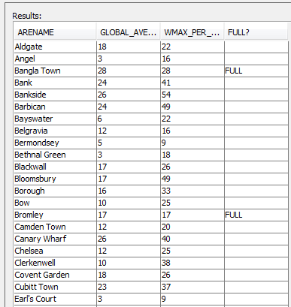
MAP-REDUCE WORKFLOW Step 4 Final Reduce-Aggregate.
Final reduce step &Ship back result to requester for final aggregation (if required)
---Final step 1 : calculating average of bikes globally
SELECT SUM( wSUM)/(SUM(wcount)) GLOBAL_AVERAGE_BIKES --2--
FROM NEW com.ibm.db2j.GaianQuery('SELECT col1, wsum, wcount --1--
FROM T1_OUT'
, 'with_provenance') Q_final_reduce
Output should be 13.
---Final step 2 : calculating average of bikes per areaname and if full capacity
SELECT col1 arename, --2--
SUM(wSUM)/(SUM(wcount)) GLOBAL_AVERAGE_BIKES_PER_AREA,
MAX(wMAX_per_AREA) wMAX_per_AREA,
CASE WHEN MAX(wMAX_per_AREA)=SUM(wSUM)/(SUM(wcount))THEN 'FULL' ELSE '' END "FULL?"
FROM NEW com.ibm.db2j.GaianQuery('SELECT col1, wsum,wcount,wMAX_per_AREA –1--
FROM T1_OUT'
, 'with_provenance') Q_final_reduce
GROUP BY col1
Results
--2--
GDB
6414
T1_out
--1--
--1--
GDB
6415
GDB
6416
T1_out
T1_out
Notes:
---Final step : calculating average of bikes globally
SELECT SUM( wSUM)/(SUM(wcount)) GLOBAL_AVERAGE_BIKES
FROM NEW com.ibm.db2j.GaianQuery('SELECT col1, wsum, wcount
FROM T1_OUT'
, 'with_provenance') Q_final_reduce
---Final step : calculating averge of bikes per areaname
SELECT col1 arename, SUM( wSUM)/(SUM(wcount)) GLOBAL_AVERAGE_BIKES_PER_AREA, MAX(wMAX_per_AREA ) wMAX_per_AREA,
CASE WHEN MAX(wMAX_per_AREA )=SUM( wSUM)/(SUM(wcount)) THEN 'FULL' ELSE ' ' END "FULL?"
FROM NEW com.ibm.db2j.GaianQuery('SELECT col1, wsum, wcount , wMAX_per_AREA
FROM T1_OUT'
, 'with_provenance') Q_final_reduce
GROUP BY col1

Slide 10

MAP-REDUCE WORKFLOW Step 5 Clean (if no reuse)
1- Clean up if tables need to be reused in the future
SELECT * FROM NEW com.ibm.db2j.GaianQuery('DELETE FROM T1_PART','with_provenance') Q_clean
SELECT * FROM NEW com.ibm.db2j.GaianQuery('DELETE FROM Q1_parts','with_provenance') Q_clean
SELECT * FROM NEW com.ibm.db2j.GaianQuery('DELETE FROM T1_out','with_provenance') Q_clean
2- DROP if tables don’t need to be reused in the future
SELECT * FROM NEW com.ibm.db2j.GaianQuery('DROP TABLE Q1_parts','with_provenance') Q_drop
SELECT * FROM NEW com.ibm.db2j.GaianQuery('DROP FROM T1_PART','with_provenance') Q_drop
SELECT * FROM NEW com.ibm.db2j.GaianQuery('DROP TABLE T1_out','with_provenance') Q_drop
GDB
6414
T1_Part
Partition table
GDB1 A H
GDB2 H L
GDB3 L ZZ
T1_out
GDB
6415
GDB
6416
T1_Part
T1_Part
Partition table
GDB1 A H
GDB2 H L
GDB3 L ZZ
Partition table
GDB1 A H
GDB2 H L
GDB3 L ZZ
T1_out
T1_out
Notes:
--clean all the Partition tables ...
SELECT * FROM NEW com.ibm.db2j.GaianQuery('DELETE FROM T1_PART','with_provenance') Q_clean
SELECT * FROM NEW com.ibm.db2j.GaianQuery('DELETE FROM Q1_parts','with_provenance') Q_clean
SELECT * FROM NEW com.ibm.db2j.GaianQuery('DELETE FROM T1_out','with_provenance') Q_clean
--drop all the Partition tables ...
SELECT * FROM NEW com.ibm.db2j.GaianQuery('DROP TABLE Q1_parts','with_provenance') Q_drop
SELECT * FROM NEW com.ibm.db2j.GaianQuery('DROP TABLE T1_PART','with_provenance') Q_drop
SELECT * FROM NEW com.ibm.db2j.GaianQuery('DROP TABLE T1_out','with_provenance') Q_drop

Slide 11
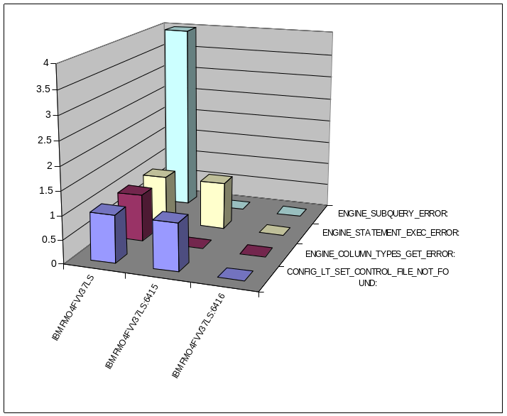
More information
Many of these steps can be reduced by combing SQL statements together.
    Q1_parts, T1_Out are not required. Can be embedded in all SQL queries or ignored is single map-reduce step.
Can automate most of these steps using a specific Java Stored Procedure.
Reduce Step can be complex, leveraging specific JAVA stored procedures or user defined functions.
  We can help build theses for you.
An exmaple: This technique can be used for analysing Gaian logs
SELECT Error_type,
SUM(Case When GDB_NODE = 'IBMFMO4FVV37LS' then cnt else 0 end ) IBMFMO4FVV37LS,
SUM(Case When GDB_NODE = 'IBMFMO4FVV37LS:6415' then cnt else 0 end) "IBMFMO4FVV37LS:6415",
SUM(Case When GDB_NODE = 'IBMFMO4FVV37LS:6416' then cnt else 0 end) "IBMFMO4FVV37LS:6415"
FROM (
SELECT GDB_NODe,substr(error_type,1, locate(':',error_type)) Error_type, count(*) cnt
FROM NEW com.ibm.db2j.GaianQuery('
select substr(column1,locate(''** '', column1)+15) error_type
from GDB_LTLOG_0
where (Column1 like ''%GDB_WARNING%'' OR Column1 like ''%GDB_ERROR%'')
and Substr(column1,locate(''** '', column1)) is not null
', 'with_provenance') GQ
Group by GDB_NODe,substr(error_type,1, locate(':',error_type))
) T
GROUP BY ERROR_TYPE
Notes:
---Analysis for errors in Gaian logs.
SELECT
Error_type,
SUM(Case When GDB_NODE = 'IBMFMO4FVV37LS' then cnt else 0 end ) IBMFMO4FVV37LS,
SUM(Case When GDB_NODE = 'IBMFMO4FVV37LS:6415' then cnt else 0 end) "IBMFMO4FVV37LS:6415",
SUM(Case When GDB_NODE = 'IBMFMO4FVV37LS:6416' then cnt else 0 end) "IBMFMO4FVV37LS:6415"
FROM (
SELECT GDB_NODe,substr(error_type,1, locate(':',error_type)) Error_type, count(*) cnt
FROM NEW com.ibm.db2j.GaianQuery('
select substr(column1,locate(''** '', column1)+15) error_type
from GDB_LTLOG_0 where (Column1 like ''%GDB_WARNING%'' OR Column1 like ''%GDB_ERROR%'') and Substr(column1,locate(''** '', column1)) is not null
', 'with_provenance') GQ
Group by GDB_NODe,substr(error_type,1, locate(':',error_type))
) T
GROUP BY ERROR_TYPE

Slide 12
Conclusion

